Slide 1
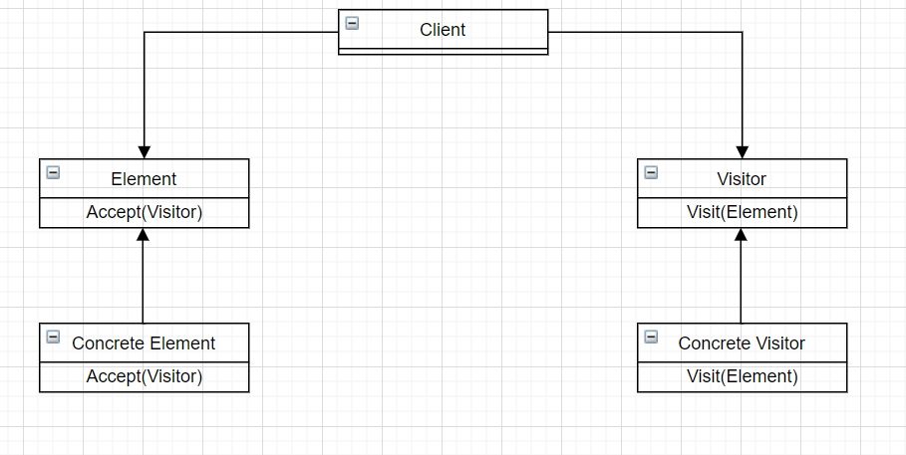
Design Pattern: Visitor
Group 9 – APCS 21 CTT2
Members:
Võ Thanh Phúc – 21125056
Nguyễn Đình Ngọc Trí - 21125065
Nguyễn Minh Vĩ – 21125067
Lê Nguyễn Đăng Khoa - 21125164

Slide 2

What’s inside our presentation?
Content:
Problems and naive solution.
Introduction to Visitor design pattern.
How to solve problem with Visitor.
Similar problem.
Pros and cons to our design pattern.

Slide 3

1. Real-World problem and naive solution
A modern problem that if we use normal-naive solution will cost a lot of efforts, time and may cause some bugs

Slide 4

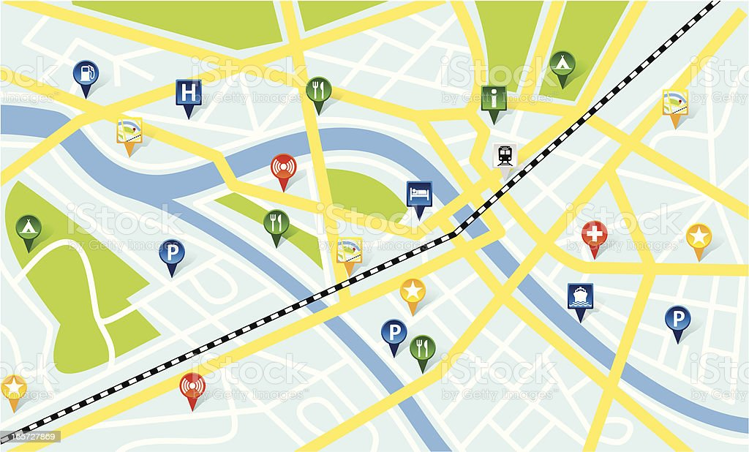
Preview to our Real-world problem
Imagine that you are building an app working with geographic information structured as one colossal graph. Each node of the graph represents a complex entity such as a city, but also more granular things like industries, sightseeing areas, etc. Each node type is represented by its own class, while each specific node is an object.

Slide 5
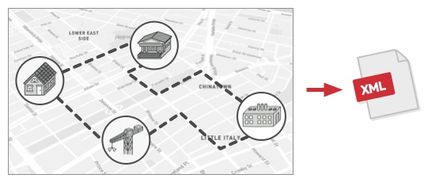
Problem:
From the graph for that city, now , we need to implement to export the graph to XML format.

Slide 6
Naive solution:
You planned to add an export method to each node class and then leverage recursion to go over each node of the graph, executing the export method.
→ This solution was simple.
#include <iostream> using namespace std; class Point { private: int x, y; public: Point() { x = y = 0; } Point(int x, int y) { this->x = x; this->y = y; } void Show() { cout << x << "," << y << endl; } };
Component export

Slide 7
Naive solution:
class Shape { public: virtual void XMLexport() = 0; };
class Circle :public Shape{ private: int ID; Point C; int Radius; public: Circle(){ ID = 2; Radius = 3; } void Show(){ cout << "Circle" << endl; C.Show(); cout << "ID = " << ID << endl; cout << "Radius = " << Radius << endl; } void XMLexport(){ Show(); } };
class Dot : public Shape { private: int ID; Point a; public: Dot() { ID = 1; } void Show() { cout << "Dot" << endl; cout << "ID = " << ID << endl; a.Show(); } void XMLexport() { Show(); } };
Consider each type of building is a different type of shapes, inherited from a class Shape
class Application { private: Shape* arr[4] = { new Dot, new Circle, new Dot, new Circle }; public: void exportXML() { for (int i = 0; i < 4; i++) arr[i]->XMLexport(); } };
Apps Export function
Export function

Slide 8
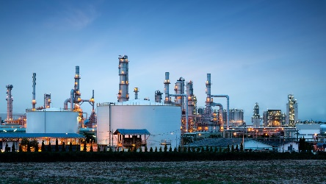


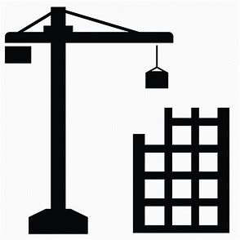
Trouble - Why we shouldn’t use it:
However, the code was already in production and by altering existing node classes, a potential bug in your changes may happens.
Industrial
</>XML Export Implementation
Residential
Existing application’s classses
Commercial
Construction

Slide 9
Trouble - Why we shouldn’t use it:
The XML export method had to be added into all node classes, which bore the risk of breaking the whole application if any bugs slipped through along with the change.
Besides, the primary job of these classes was to work with geodata. If this feature was implemented and your client would ask you to provide the ability to export into another format or request some other weird stuff, this would force you to change those precious and fragile classes again. The solution would then become complicated and cause errors.

Slide 10
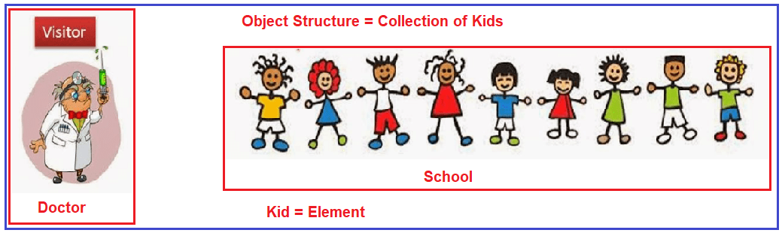
2. An introduction about Visitor pattern

Slide 11
What is Visitor?
Visitor a behavioral design pattern that lets you to define a new operation without changing the class of elements on which the object operates.
So, what is the key idea to understand visitor?

Slide 12
Main idea-Visitor:
The Visitor pattern suggests that you place the new behavior into a separate class called visitor, instead of trying to integrate it into existing classes. The original object that had to perform the behavior is now passed to one of the visitor’s methods as an argument, providing the method access to all necessary data contained within the object.

Slide 13
Technique - Property
The Visitor pattern uses a technique called Double Dispatch, which helps to execute the proper method on an object without cumbersome conditionals. Instead of letting the client select a proper version of the method to call, we delegate this choice to objects we’re passing to the visitor as an argument. Since the objects know their own classes, they’ll be able to pick a proper method on the visitor.
→ Fact: We can say they “accept” a visitor and tell it what visiting method should be executed.

Slide 14
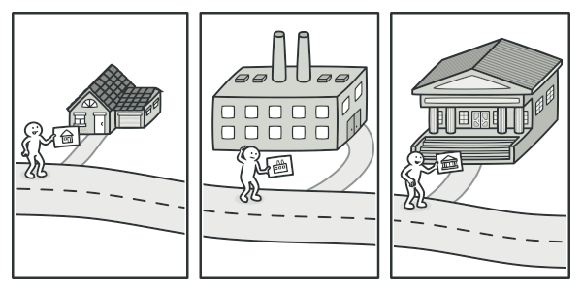
Illustration
A good insurance agent is always ready to offer different policies to various types of organizations.

Slide 15
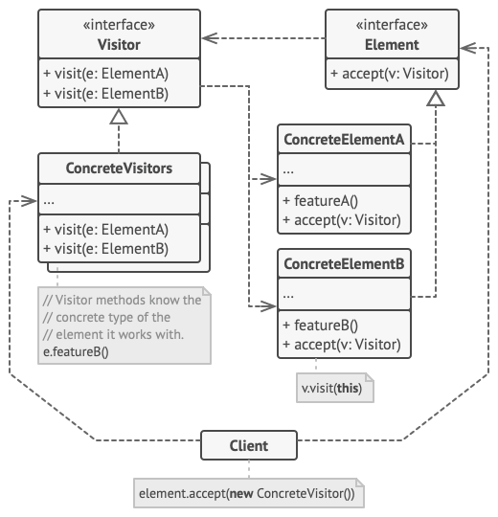
General Class Diagram - Explanation
The Visitor interface declares a set of visiting methods that can take concrete elements of an object structure as arguments. These methods may have the same names if the program is written in a language that supports overloading, but the type of their parameters must be different.
Each Concrete Element must implement the acceptance method. The purpose of this method is to redirect the call to the proper visitor’s method corresponding to the current element class. Be aware that even if a base element class implements this method, all subclasses must still override this method in their own classes and call the appropriate method on the visitor object.
The Element interface declares a method for “accepting” visitors. This method should have one parameter declared with the type of the visitor interface.
Each Concrete Visitor implements several versions of the same behaviors, tailored for different concrete element classes.

Slide 16
General Class Diagram - Explanation
The Client usually represents a collection or some other complex object (for example, a Composite tree). Usually, clients aren’t aware of all the concrete element classes because they work with objects from that collection via some abstract interface.

Slide 17
NOW, LET’S COMEBACK TO OUR MAIN PROBLEM.
Check out class diagram for solution to our problem.

Slide 18
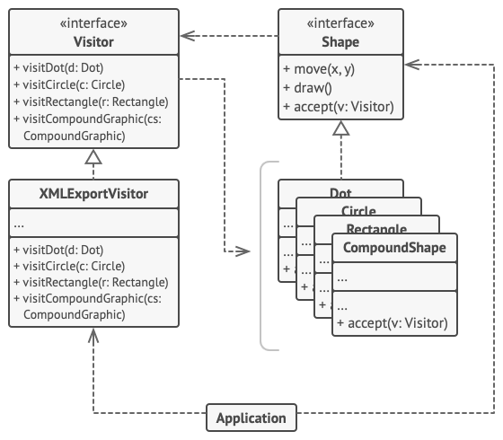
Class diagram for problem
The Visitor pattern adds XML export support to the class hierarchy of geometric shapes.

Slide 19
Explain on class diagram:
Shape is equivalent to Element in the diagram, and the list of Shape equivalent to Concrete Element. The application is the Client we’re looking for.

Slide 20

implementation for visitor in this problem

Slide 21
Print Slide Master
Our PowerPoint templates and backgrounds are «pre-made» presentation shells («pre-made» slides). All design backgrounds, graphics, typefaces, and colors have been created and are pre-set by an expert graphic designers which are working with some of the most prominent businesses in the world.
You simply insert your text. That's it! You just can't go wrong with these templates and backgrounds!
Download this template as well as our others at http://poweredtemplate.com/technology-computers-ppt-powerpoint-templates.html

Slide 22
Print Slide Master
Our PowerPoint templates and backgrounds are «pre-made» presentation shells («pre-made» slides). All design backgrounds, graphics, typefaces, and colors have been created and are pre-set by an expert graphic designers which are working with some of the most prominent businesses in the world.
You simply insert your text. That's it! You just can't go wrong with these templates and backgrounds!
Download this template as well as our others at http://poweredtemplate.com/technology-computers-ppt-powerpoint-templates.html

Slide 23
Print Slide Master
Our PowerPoint templates and backgrounds are «pre-made» presentation shells («pre-made» slides). All design backgrounds, graphics, typefaces, and colors have been created and are pre-set by an expert graphic designers which are working with some of the most prominent businesses in the world.
You simply insert your text. That's it! You just can't go wrong with these templates and backgrounds!
Download this template as well as our others at http://poweredtemplate.com/technology-computers-ppt-powerpoint-templates.html

Slide 24
Print Slide Master
Our PowerPoint templates and backgrounds are «pre-made» presentation shells («pre-made» slides). All design backgrounds, graphics, typefaces, and colors have been created and are pre-set by an expert graphic designers which are working with some of the most prominent businesses in the world.
You simply insert your text. That's it! You just can't go wrong with these templates and backgrounds!
Download this template as well as our others at http://poweredtemplate.com/technology-computers-ppt-powerpoint-templates.html

Slide 25
Print Slide Master
Our PowerPoint templates and backgrounds are «pre-made» presentation shells («pre-made» slides). All design backgrounds, graphics, typefaces, and colors have been created and are pre-set by an expert graphic designers which are working with some of the most prominent businesses in the world.
You simply insert your text. That's it! You just can't go wrong with these templates and backgrounds!
Download this template as well as our others at http://poweredtemplate.com/technology-computers-ppt-powerpoint-templates.html

Slide 26
Print Slide Master
Our PowerPoint templates and backgrounds are «pre-made» presentation shells («pre-made» slides). All design backgrounds, graphics, typefaces, and colors have been created and are pre-set by an expert graphic designers which are working with some of the most prominent businesses in the world.
You simply insert your text. That's it! You just can't go wrong with these templates and backgrounds!
Download this template as well as our others at http://poweredtemplate.com/technology-computers-ppt-powerpoint-templates.html

Slide 27
Print Slide Master
Our PowerPoint templates and backgrounds are «pre-made» presentation shells («pre-made» slides). All design backgrounds, graphics, typefaces, and colors have been created and are pre-set by an expert graphic designers which are working with some of the most prominent businesses in the world.
You simply insert your text. That's it! You just can't go wrong with these templates and backgrounds!
Download this template as well as our others at http://poweredtemplate.com/technology-computers-ppt-powerpoint-templates.html

Slide 28
Print Slide Master
Our PowerPoint templates and backgrounds are «pre-made» presentation shells («pre-made» slides). All design backgrounds, graphics, typefaces, and colors have been created and are pre-set by an expert graphic designers which are working with some of the most prominent businesses in the world.
You simply insert your text. That's it! You just can't go wrong with these templates and backgrounds!
Download this template as well as our others at http://poweredtemplate.com/technology-computers-ppt-powerpoint-templates.html

